Slide 1

Quantum CAPITAL LLC
ENERGY Fund Prospectus
“Driving capital markets through algorithmic design”

Slide 2

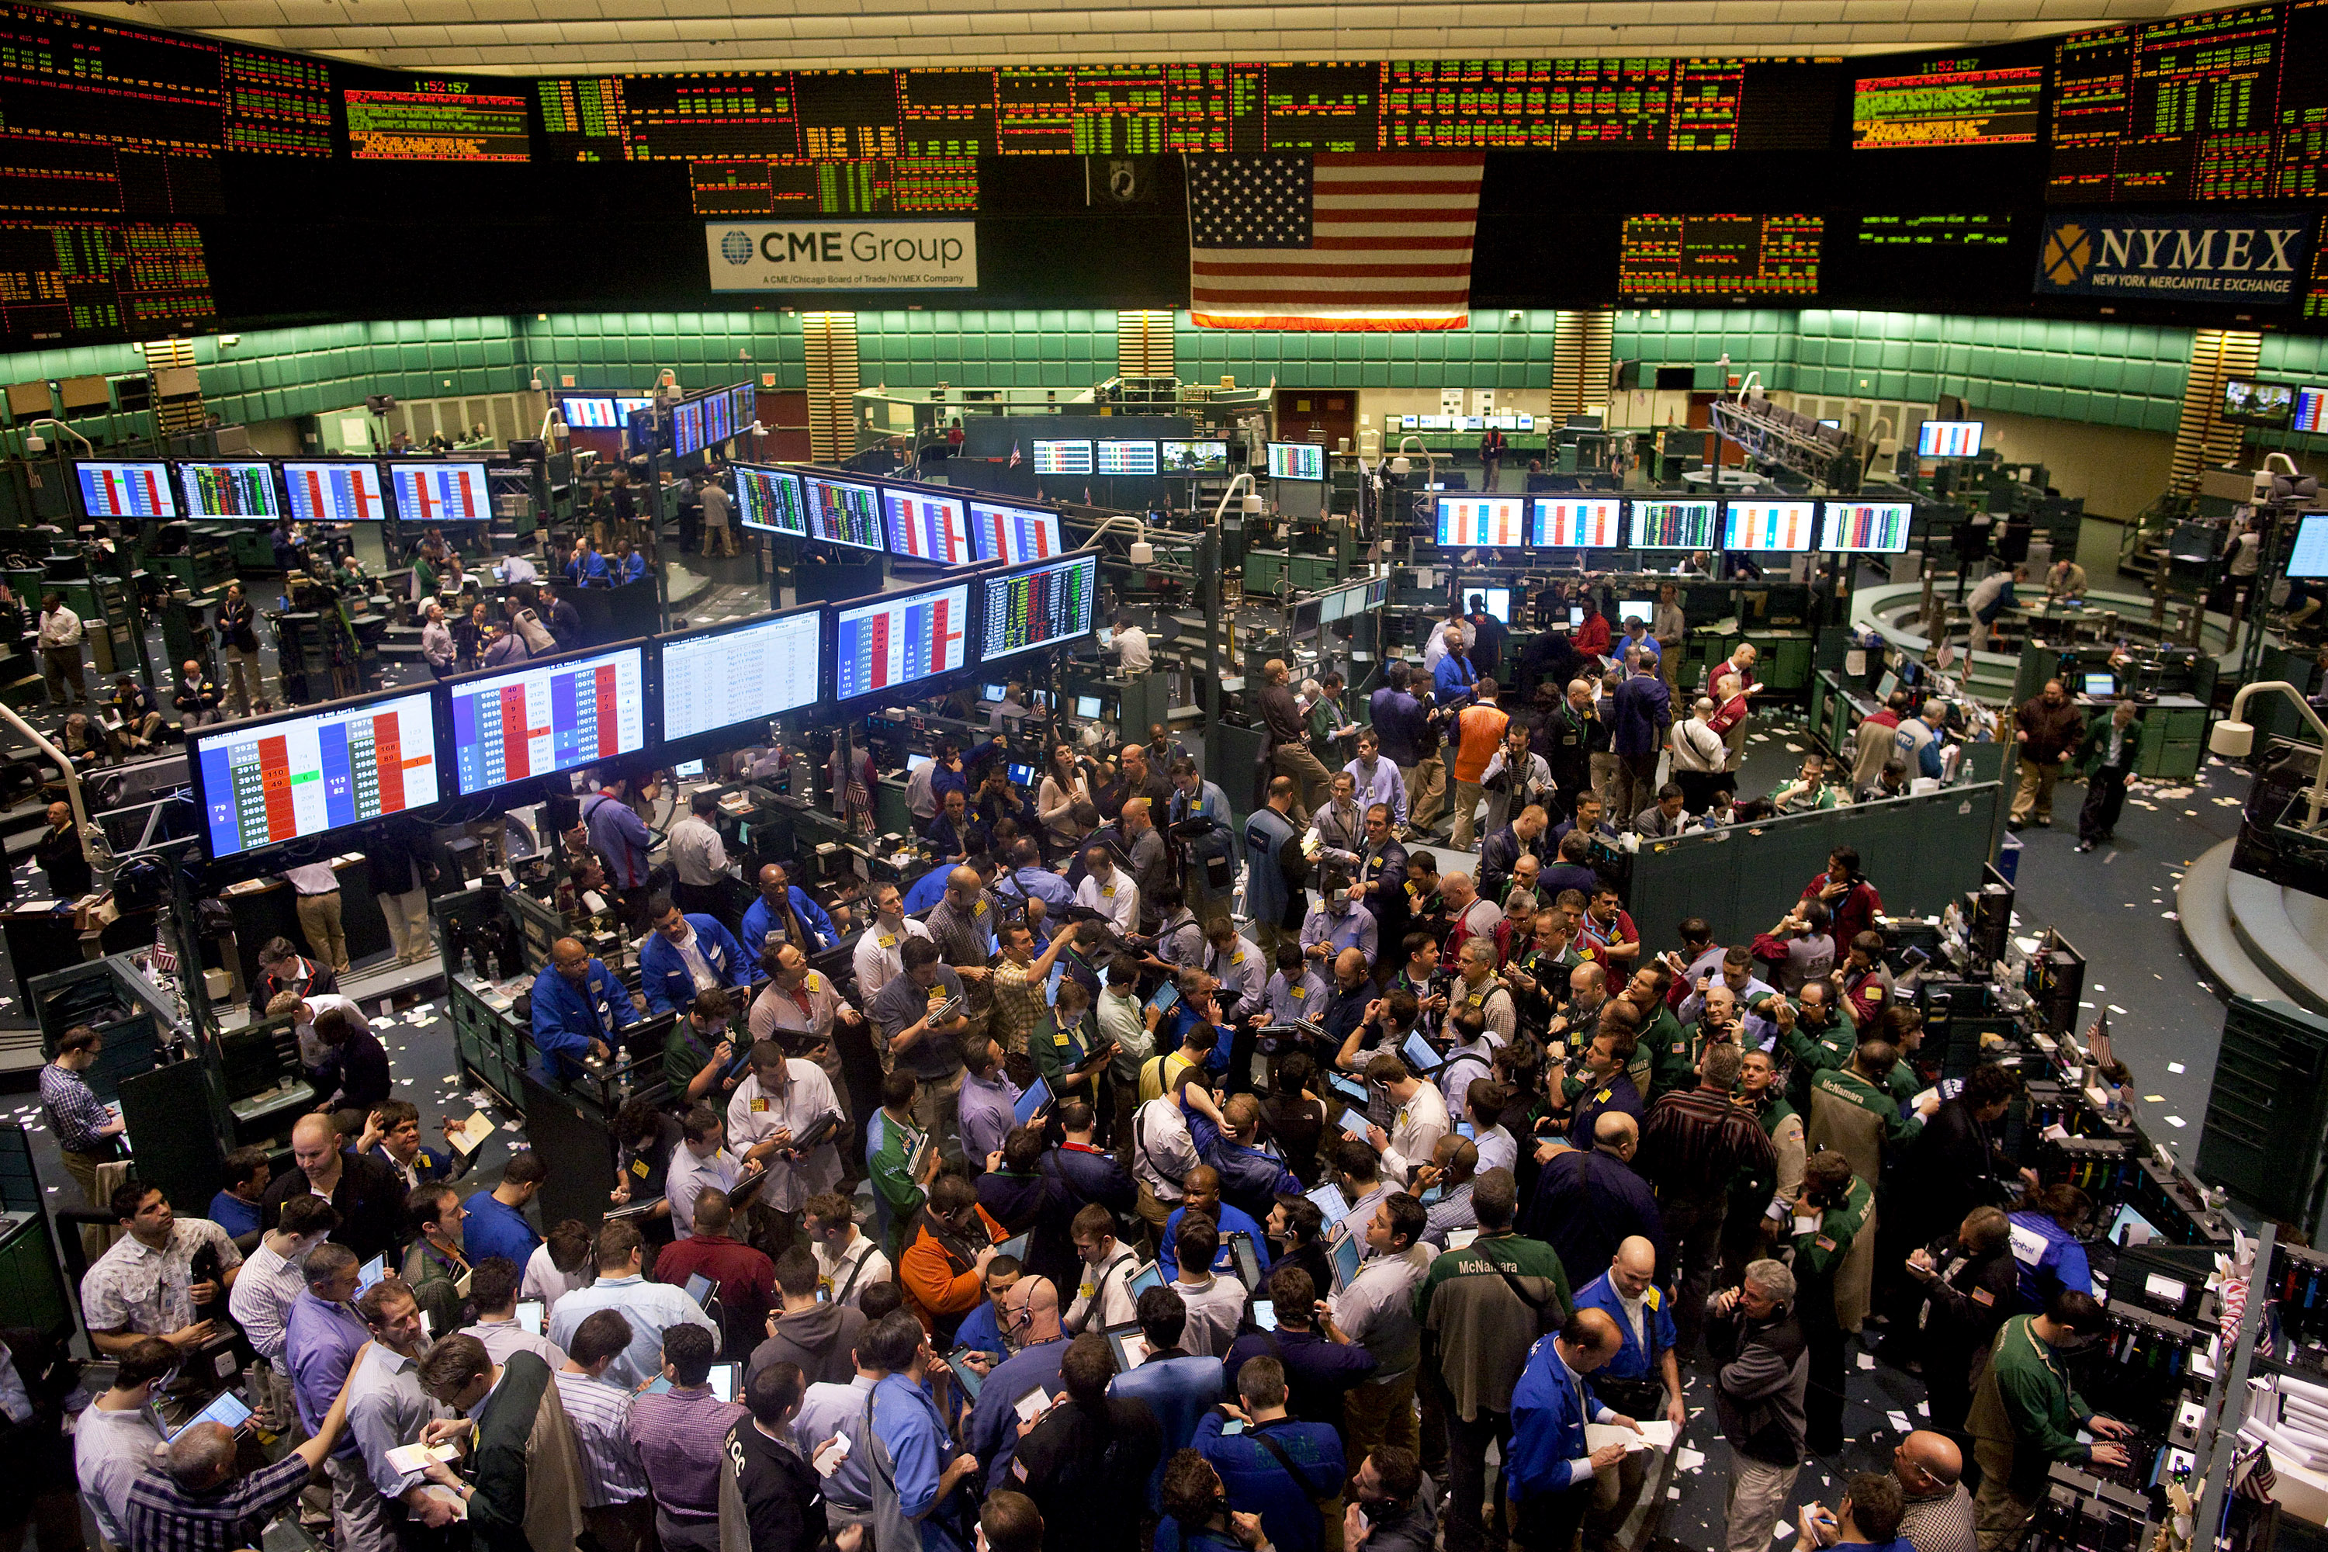
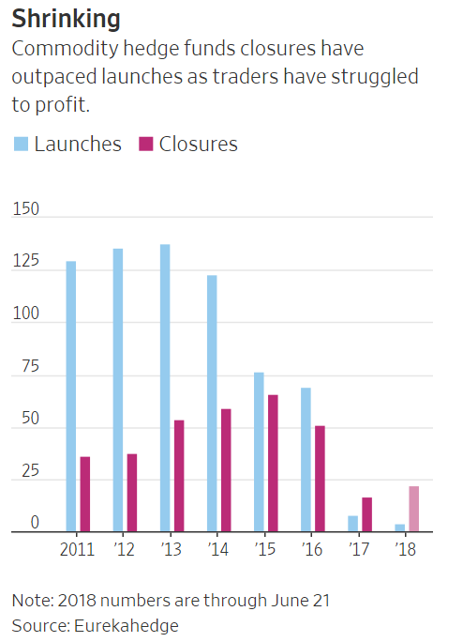
Slide 7
The Opportunity
In 2017, closures of commodities hedge funds outnumbered launches for the first time in data going back to 2000, according to data provider Eurekahedge—a trend that has continued into this year. The reason? Investors who were burned by the severe two-year market rout that started in 2014 aren’t rushing back, fund managers and traders say, despite prices of commodities, including oil, copper, lumber and cotton, all rebounding to multiyear highs.
BACKGROUND
Quantum Capital Management LLC is new private fund management company in fundamental commodity strategies with a specialization in the oil and energy complex. Quantum Capital is led by a team of data scientists. The investment strategy targets absolute returns with an asymmetric upside, via detailed supply and demand forecasting, fundamental, macro economic and physical market information combined with various technical market indicators to generate fair values, forecasts and trading signals for energy and commodities.
~ 5 Years
The Challenge
of Data
Extract insights from over a 1000 separate data sources consisting of 5 years of data and over 4000 variables. Data sources include: Department of Energy, Chicago Mercantile Exchange and various Global Indexes
The data is both unstructured and structured to fit into a data warehouse.
4000+
Variables

Slide 3
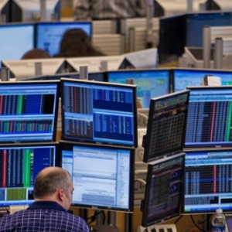
KEY characteristics of our strategy.
Story: Identify key signals in scenarios that correlate strongly with the probability that the market has continuously mispriced futures prices in these situations, creating opportunities to earn market returns but with significantly less risk.
Process:
Download, track and store activity in an energy sector
Apply various data munging and feature extraction techniques
Fit various algorithms and machine learning techniques on the data sets.
Back test strategy and forecast result
Returns: Working in a team of 4 using two portfolio strategies with $20 million in capital, we would like to averaged 11% annual returns, always in a relatively narrow band from 8% to 15% in any given year.

Slide 4
Solution Overview
Explore
Explored multiple data sources from exchanges to government web sites.
Download data from paid and unpaid sources.
Analyze
Analyzed important predictors and extracted key features to predict loan default
Deploy
C# Application for Pattern Search
Dashboard CEO Mobile Application
Top Model: Mean Reversion Strategies using GARCH
Evaluate different platforms and technologies.
Understand Energy Market Sector and more importantly the volatility associated with it.
Dashboard and Mobile App
Final DataSet:
5 Years of Data and 89 Predictors
Prepare
Model
Consolidated data sources , imputed missing values, transformed outliers and skewed variables, created derived variables.
Built several models: Linear Regression(Polynomial, Ridge and Lasso)
Gaussian Mixed Mixture
ARIMA
GARCH
Random Forest
XGBOOST
Deep Learning(RNN-Tensor)

Slide 5
strategy Summary performance
Crude Oil WTI – 1/1/19 – 10/30/19
Data pre-processing, normalization and augmentation.
Risk profiles for each of the various assets & corresponding parametric model estimates.
Preliminary time series analysis & statistical correlations for Crude products
A predictive model for WTI, Brent, Gasoline and corresponding trading strategy (mean-revision).
Initial backtest results yield net positive PnL and returns for the testing period (2019).
WTI mean revision strategy performance is 26.11% year to date.
The trade execution / PnL dashboard is functional locally.
Commodity | Strategy | Benchmark
23.1% | 26.11% | 3.74%
30.8% | 34.81% | 4.99%
Periodic
Annualized
Crude Oil Brent – 1/1/19 – 10/30/19
Commodity | Strategy | Benchmark
13.45% | 16.8% | 3.74%
17.94% | 22.4% | 4.99%
Crude Oil - Brent
Periodic
Annualized
Gasoline – 1/1/19 – 10/30/19
Commodity | Strategy | Benchmark
23.8% | 43.85% | 3.74%
31.8% | 58.45% | 4.99%
Periodic
Annualized

Slide 6
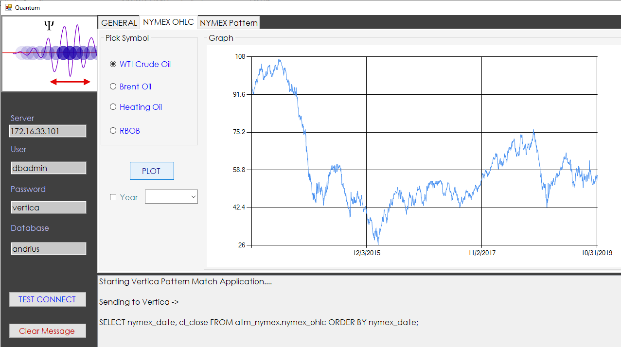
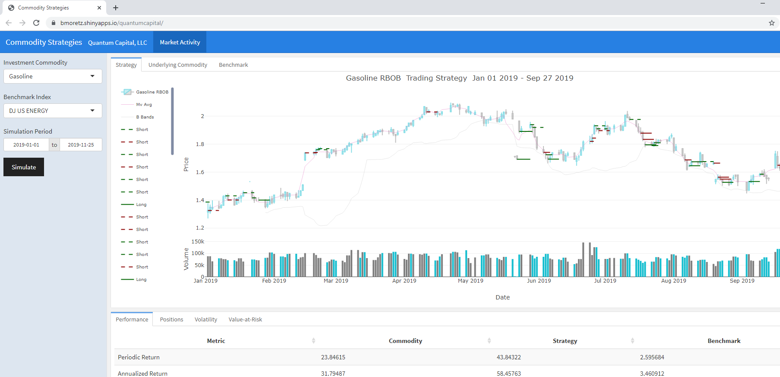
Dashboard & Mobile APP
C# Windows Form Application
Mobile App
A C# Windows application to search for patterns in the data and a GUI to plot energy symbols.
A browser centric application designed to provide a quick simulation of various strategies and back testing frameworks. Can work from any device via a browser and is live.

Slide 7
Thank you!
Feel free to contact any one of us…..

